Slide 1

Slugfit
We see mass in your future

Slide 2
OUR TEAM
Nicholas Gunner Spencer
Product Owner
Zack Traczyk
Scrum Master #3
Kevin Luong
Oliver Hu
Shaan Mistry
Scrum Master #1
Paul Simbulan
Scrum Master #2

Slide 3
About Slugfit
Problems
No good social apps for weightlifting (like Strava is for running)
No easy method to create, use, and share workouts (like Notion is for notes)
Opportunity
Weightlifting mobile app that provides a Notion-like workout customization interface and a way to share completed workouts with friends.
User = Weightlifter that wants to design their own workouts

Slide 4
Goals
Set out to Achieve | Achieved
Signup and Login with an account
Design and use workouts on a mobile device
Workout history with Calendar view
Track exercise-specific progress over time
All data to persists even after logging out
Add friends
Share workouts with friends
Publish to and view a feed of you and your friends’ workouts completed

Slide 5
DEMO TIME

Slide 6
Create Account
Sign In
Authentication

Slide 7
New Workout, Add Exercises
Add Sets, Notes, Rest
Create Workouts
Duplicate, Delete, Drag
Filter Exercises, Delete

Slide 8
Start Workout, Navigate
Enter your stats
Use Workouts
Complete Workout, Save
View Workout Summary

Slide 9
View Past Performance
Edit Your Profile
Profile & Analytics
See Exercise Progress
Compare Exercises

Slide 10
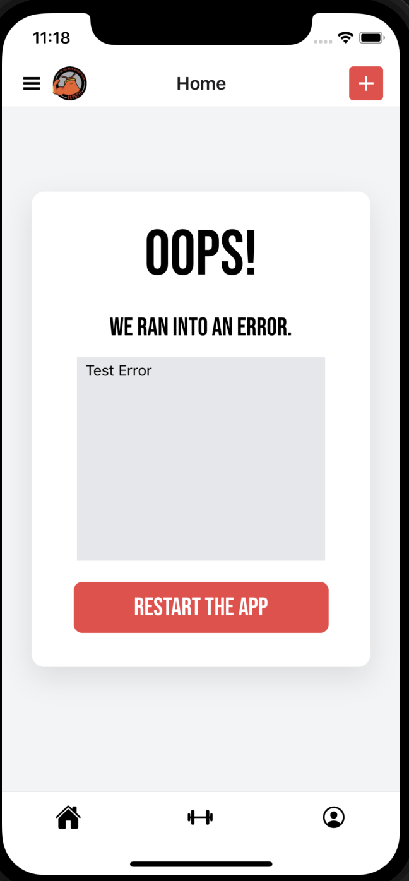
Drawer Navigation
Error Handling
Navigation & Error Handling

Slide 11
Search for and Add Friends
See Posts from multiple friends
Social Sharing
View Summary, Duplicate Workout
Unfollow friends

Slide 12
System Overview
Discard Workout
Start Workout
Consumable Workout
Object
Local Storage
Save Workout
Home
Edit Workout
Edit Exercise
Editable Workout
Object
Users
Authentication
Profile
Edit Profile
Profile Object
Social Feed
Sign out
Workout History / Analytics
Supabase

Slide 13
Technologies
Frontend
Expo
React Native
TailwindCSS
Backend
Javascript/Typescript
Supabase
PostgreSQL
UI Design
Figma
Source Control
Github

Slide 14
Challenges / Risks
Developing surprisingly complex features in a small period of time
Coordination when working on the same feature
Keeping Code to Standards
3
2
4
Unfamiliar Technology
5
1
Time management

Slide 15
Project Management
Scrum:
Strict practices (scrum master does their job and product manager as well)
Meetings 3x a week
Updates scrum board
Each person announces what they did, they’re doing, and any problems they encounter
Pair Programming
Communication:
Open communication on Discord
Scrum Board:
Notion
Source Control:
Github
Code Review Required before merging
Pull Request with required checks + reviews

Slide 16
Things We Enjoyed
Separate features of the app come all together as one cohesive application
Camaraderie: hanging out even outside of the app (like working out together)
Learning about different technologies
Learning from others
Fully committing to Scrum Methodology

Slide 17
Not So Fun…
Debugging
Practicing Agile Methodologies on top of schoolwork
Setting up frameworks
Merging/ Merge Conflicts

Slide 18
Lessons Learned
Keep Doing
Stop Doing
Should’ve Done
Implementing a UI Design early on
Merging everything at the last second
More code documentations
Strong commitment to Scrum Methodologies
Missing meetings
Study other apps for ideas

Slide 19
Thanks
SLUGFIT
We see mass in your future

